Slide 1
Employee Data Analysis using Excel
STUDENT NAME : Jayashree.B
REGISTER NO : 312218871
DEPARTMENT : B.com(Bank Management)
COLLEGE : Avichi college of Arts and science
NM id : 26B02F8BAEAC8958C5B4FE29E1EA1B85

Slide 2
PROJECT TITLE
Employee Performance Analysis using Excel

Slide 3


AGENDA
Problem Statement
Project Overview
End Users
Our Solution and Proposition
Dataset Description
Modelling Approach
Results and Discussion
Conclusion
3/21/2024 Annual Review

Slide 4

PROBLEM STATEMENT
Data Accuracy and Completeness: The employee database is prone to errors and incomplete entries, making it difficult to track the progress and outcomes of participants. Inaccurate or missing information can lead to mismanagement of training and placement.
Integration with Training Programs: There is a lack of seamless integration between the employee database and the various training programs offered under the initiative. This makes it challenging to tailor training programs to the specific needs of participants based on their skills, qualifications, and employment history.
Real-time Updates and Tracking: The current system does not allow for real-time updates and tracking of employee progress, making it difficult to monitor the effectiveness of training programs and make timely adjustments.

Slide 5

PROJECT OVERVIEW
Objective: Develop a secure and efficient employee database for the "Naan Mudhalvan" initiative.
Challenges: Issues with data accuracy, real-time updates, integration with training programs, data security, and job matching.
Key Features: Accurate data entry, real-time tracking, seamless integration, enhanced security, and intelligent job matching.
Outcome: Improved participant tracking, data security, and better employment outcomes.
.

Slide 6

WHO ARE THE END USERS?
HR Managers Recruiters
Employees Payroll
Finance Teams
Department Managers Supervisors
IT Administrators
Compliance Officers
Executives
Senior Management

Slide 7

OUR SOLUTION AND ITS VALUE PROPOSITION
Our Solution:
A secure, scalable employee database system that streamlines HR processes and ensures data accuracy
Value Proposition:
Efficiency: Automates HR tasks and reduces errors.
Accuracy: Provides precise and up-to-date information.
Security: Protects sensitive data with advanced security features.
Real-time Access: Enables timely decision-making.
Scalability: Adapts to organizational growth.

Slide 8
Dataset Description
Employee ID: Unique identifier.
Personal Information: Name, contact details, address.
Employment Details: Job title, department, hire date.
Performance Data: Reviews, ratings.
Compensation Information: Salary, benefits.
Attendance Records: Time and leave records.
Training and Development: Courses and certifications.
Document Management: Contracts, ID proofs.

Slide 9

THE "WOW" IN OUR SOLUTION
Seamless Integration: Fits smoothly with existing systems.
Advanced Analytics: Delivers insightful data reports.
User-Friendly Interface: Easy to navigate.
Real-Time Updates: Provides instant data access.
Customizable: Adapts to specific needs.
Enhanced Security: Protects sensitive information.
3/21/2024 Annual Review
9

Slide 10
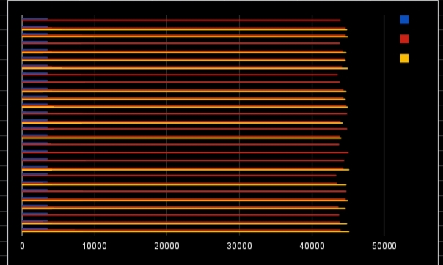
RESULTS
Employee data base bar chart
10

Slide 11
conclusion
An effective employee database improves HR efficiency, ensures accurate record-keeping, and enhances data management. Key strengths include user-friendliness and strong security, while common areas for improvement involve addressing data redundancy and access controls. Future upgrades should focus on resolving these issues and adapting to changing needs.

